Slide 1

Rule Amendments
Effective
March 1, 2016

Slide 2
Summary of Amendments
Rule 2.105 (East Region)
Rule 3.101-2 (West Region & Rules Committee)
Rule 3.101-3 (East Region & Rules Committee)
Rule 3.102 (East Region)
Rule 3.103 (South Region & Rules Committee)
Rule 5.101-2 (Rules Committee) *New Rule
Rules 3.101-1, 3.103, 3.106, 4.111, 5.103 (Executive Committee & Rules Committee)

Slide 3
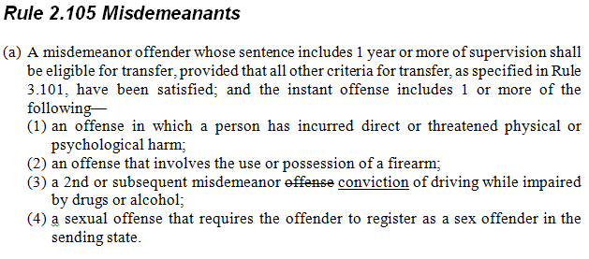
Rule 2.105 (East Region)

Slide 4
Rule 2.105 (East Region)
Clarifies that there must be a previous conviction of DUI/DWI for an eligible misdemeanor
No change in application of the rule
IMPACT
ICOTS: None
Rule/Opinion: None

Slide 5
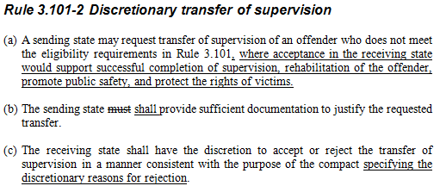
Rule 3.101-2 (West Region & Rules Committee)

Slide 6
Rule 3.101-2 (West Region & Rules Committee)
Increase the likelihood for acceptance of discretionary cases by providing more information that supports the purpose of the compact
IMPACT
ICOTS: None
Rule/Opinion: None

Slide 7
Training Tips
Sending State
Field Staff
Emphasize importance of good justifications
Incorporate purposes of the compact
Compact Office
Review, Review, Review!!
Justification warrants an acceptance?
Receiving State
Field Staff
Reject with detailed reasons for rejection
Compact Staff
Review, Review, Review!!
Make sure rejections are detailed specifying the deficiencies of the justification.
Notes:
Discretionary assessments show that states which do a good job reviewing outgoing disc transfers and only send transfers with good justifications have a much higher acceptance rate

Slide 8
Justification Elements
Good discretionary justifications demonstrate an acceptance in the Receiving State will likely result in:
Successful Completion of Supervision
Public Safety
Rehabilitation of Offenders
Protect Rights of Victims
Notes:
All transfers should be submitted for a good reason. Good discretionary justifications incorporate the purposes of the compact

Slide 9
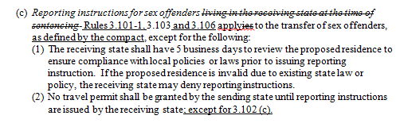
Rule 3.101-3 (East Region & Rules Committee)

Slide 10
Rule 3.101-3 (East Region & Rules Committee)
Expands the 5 days for response to all RI reasons for sex offenders in order to review proposed residence
Clarifies that sex offenders may travel daily for employment or medical purposes pending transfer under Rule 3.102(c) without formal reporting instructions
IMPACT
ICOTS: $18,000
Rule/Opinion: None

Slide 11
Training Tips
Sending State
Field Staff
Check addresses when possible
5 day for response
No travel permits without approved reporting instructions!
Compact Office
Assist field staff in verifying information to reduce denials
Receiving State
Compact Office
Compact Workload due dates reflect 5 business day for sex offenders

Slide 12
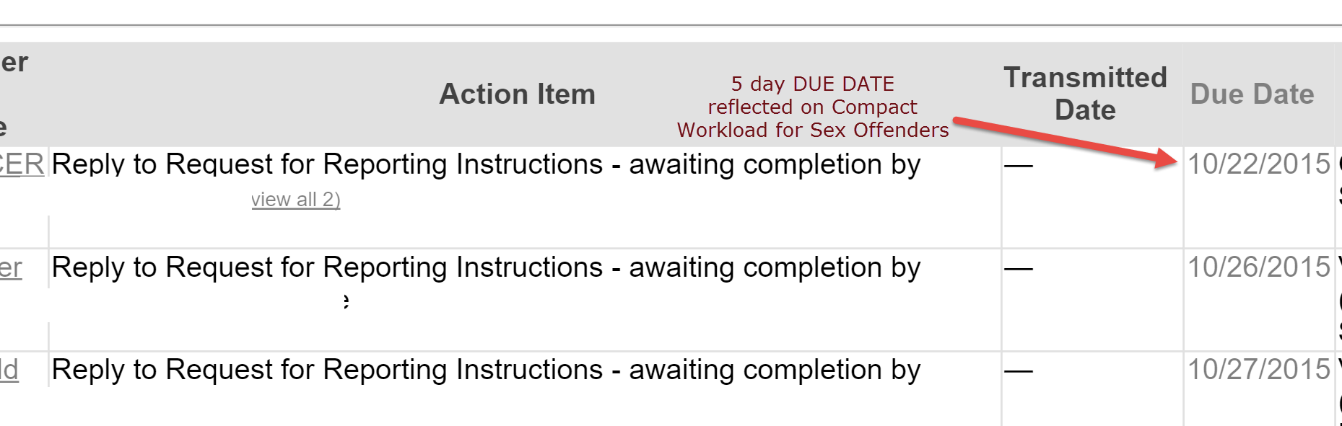
ICOTS Impact
Due dates will reflect 5 day response for ALL sex offender RFRIs (Receiving State Compact Office)

Slide 13
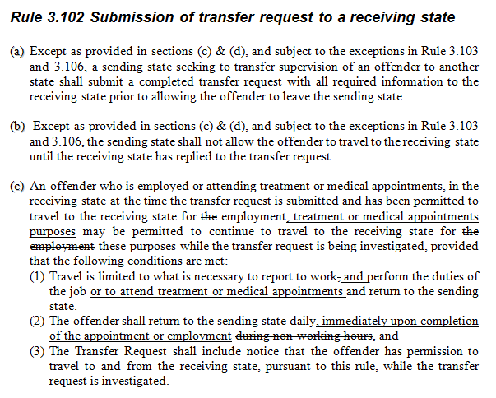
Rule 3.102 (East Region)

Slide 14
Rule 3.102 (East Region)
Provides exemption for travel to a receiving state pending transfer for medical appointment or treatment
Similar concept to border situation when offender is employed in the receiving state at the time of request
IMPACT
ICOTS: None
Rule/Opinion: None

Slide 15
Sending State Training Tips
Field Staff
Typically border situation-same concept as daily travel for work
Not for seeking new treatment or medical appointments
Returns daily and only allowed for appointments
Not inpatient treatment
Compact Staff
Ensure TR mentions the travel

Slide 16
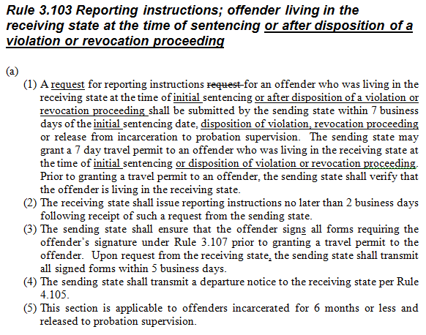
Rule 3.103 (South Region & Rules Committee)

Slide 17
Rule 3.103 (South Region & Rules Committee)
Expands Rule 3.103’s reporting instruction requirement to offenders living in the receiving state at the time of
disposition of a violation
revocation sentencing
IMPACT
ICOTS: $2,300
Rule/Opinion: None

Slide 18
Sending State Training Tips
Field Staff
Transfer can still be denied-ensure plan is valid
Chance for successful supervision exists in Receiving State
Don’t abuse the option
Compact Staff
Pay special attention to transfer reason & justification
Typically ‘Residents’
Remaining in the sending state would create a clear hard-ship for the offender
Receiving State should consider likeliness of offender
returning when reporting violations/requiring retake

Slide 19
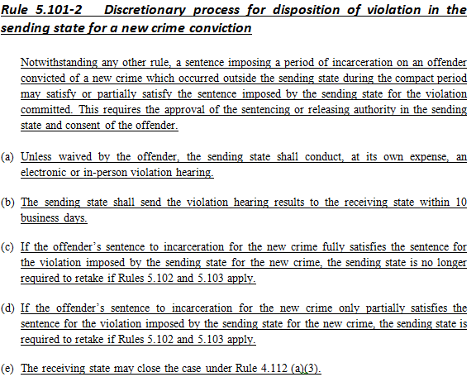
Rule 5.101-2 (Rules Committee) *New Rule

Slide 20
Rule 5.101-2 (Rules Committee) *New Rule
Provides the sending state with an optional process to address a new conviction violation while the offender is incarcerated in another state for a new crime.
Sending state INTENDS to REVOKE
IMPACT
ICOTS: None
Rule/Opinion: None

Slide 21
This Rule is Intended to:
promote “swift and certain” violation sanctions as advocated by justice reinvestment
promote joint and cooperative supervision of offenders who commit new crimes outside the sending state
provide for offender accountability
promote victim safety
Notes:
States should consider the intentions for the rule when considering application of the rule. Allows the sending state to address a violation for a conviction of a new crime timely

Slide 22
This Rule is Intended to:
allocate supervision responsibility between sending and receiving states in the interest of public safety
reduce costs to states associated with retaking offenders where imposition of sentence can best be carried out by the supervising state
increase the likelihood that supervision is continued in lieu of early termination of supervision
Notes:
States should consider the intentions for the rule when considering application of the rule. Allows the sending state to address a violation for a conviction of a new crime timely

Slide 23
Responsibilities
Sending State
Receiving State/Outside State
Decide to hold a violation hearing with offender incarcerated in another state
Coordinate with other state & other stakeholders
Receive appropriate authority approval
Consent of the offender
Conduct Hearing/Waiver
Send Hearing Results within 10 business days
Provide conviction & sentence information to the sending state
Close Case if appropriate under Rule 4.112 (a)(3)

Slide 24
Sending State Training Tips New Conviction Violations Only!
Field Staff & Local Legal Department
Requires consent:
Offender
Release/sentencing authority
No special ICOTS process
May use CAR or addendum depending on case status
Coordinate with Compact Office
Notes:
National training efforts for field staff won’t highlight this rule. States should be responsible for determining whether to use the process and develop procedures for implementation.

Slide 25
Sending State Training Tips New Conviction Violations Only!
Compact Staff
Discretionary Process
Ensure communication flows through the compact office
Not for early termination in lieu of retaking
Procedures for hearing may need to be developed if rule will be used
Work with local stake holders
Understand due process requirements in your state
Notes:
National training efforts for field staff won’t highlight this rule. States should be responsible for determining whether to use the process and develop procedures for implementation.

Slide 26
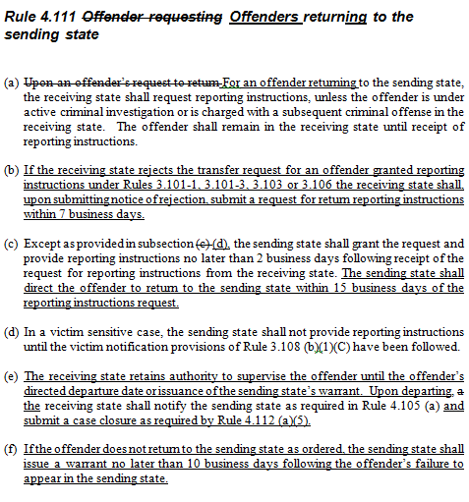
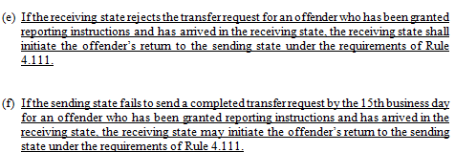
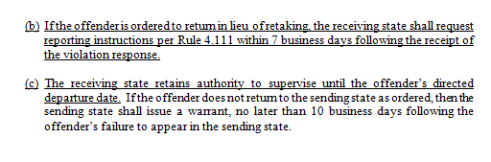
Rules 3.101-1, 3.103, 3.106, 4.111, 5.103 (Executive Committee & Rules Committee)

Slide 27
Rules 3.101-1, 3.103, 3.106, 4.111, 5.103 (Executive Committee & Rules Committee)
Creates standard TRACKING procedure for offenders returning due to
Request to return
Rejected transfer request after approved reporting instructions
Returning in lieu of retaking for violation
IMPACT
ICOTS: None
Rule/Opinion: None

Slide 28
Enhanced Tracking
Tracks return for ALL offenders on active supervision to the sending state
Uses existing ICOTS functionality
Emphasizes communication
Both states know where the offender is leaving from and going to
RFRI tip: If unsuccessful in obtaining offender address, RS may enter the SS local field office.
The SS’s response should provide specific reporting/return instructions.
Notes:
Being party to the compact ALL states are responsible in promoting public safety, tracking offender movement
Tracking offender movement is everyone’s job involved!

Slide 29
Request to Return Training Tips
Receiving State
No substantial change in rule application for offenders requesting to return
Ensure no pending charges exist in receiving state
Sending State
Report date must be within 15 days of RFRI
Notify victims if needed
Must provide Reporting Instructions
Warrant required if offender fails to return

Slide 30
Return for Rejected Offenders Training Tips
Receiving State
Initiate if offender is truly rejected within 7 business days
Not for incomplete transfers
Do not request when it is appropriate for the offender to remain in the receiving state pending resubmission of a new transfer request
Supervise until departure
Sending State
Report date must be within 15 days of RFRI
Notify victims if needed
Must provide Reporting Instructions
RS’s failure to request within 7 day timeframe does not eliminate obligation for RI’s
Warrant required if offender fails to return

Slide 31
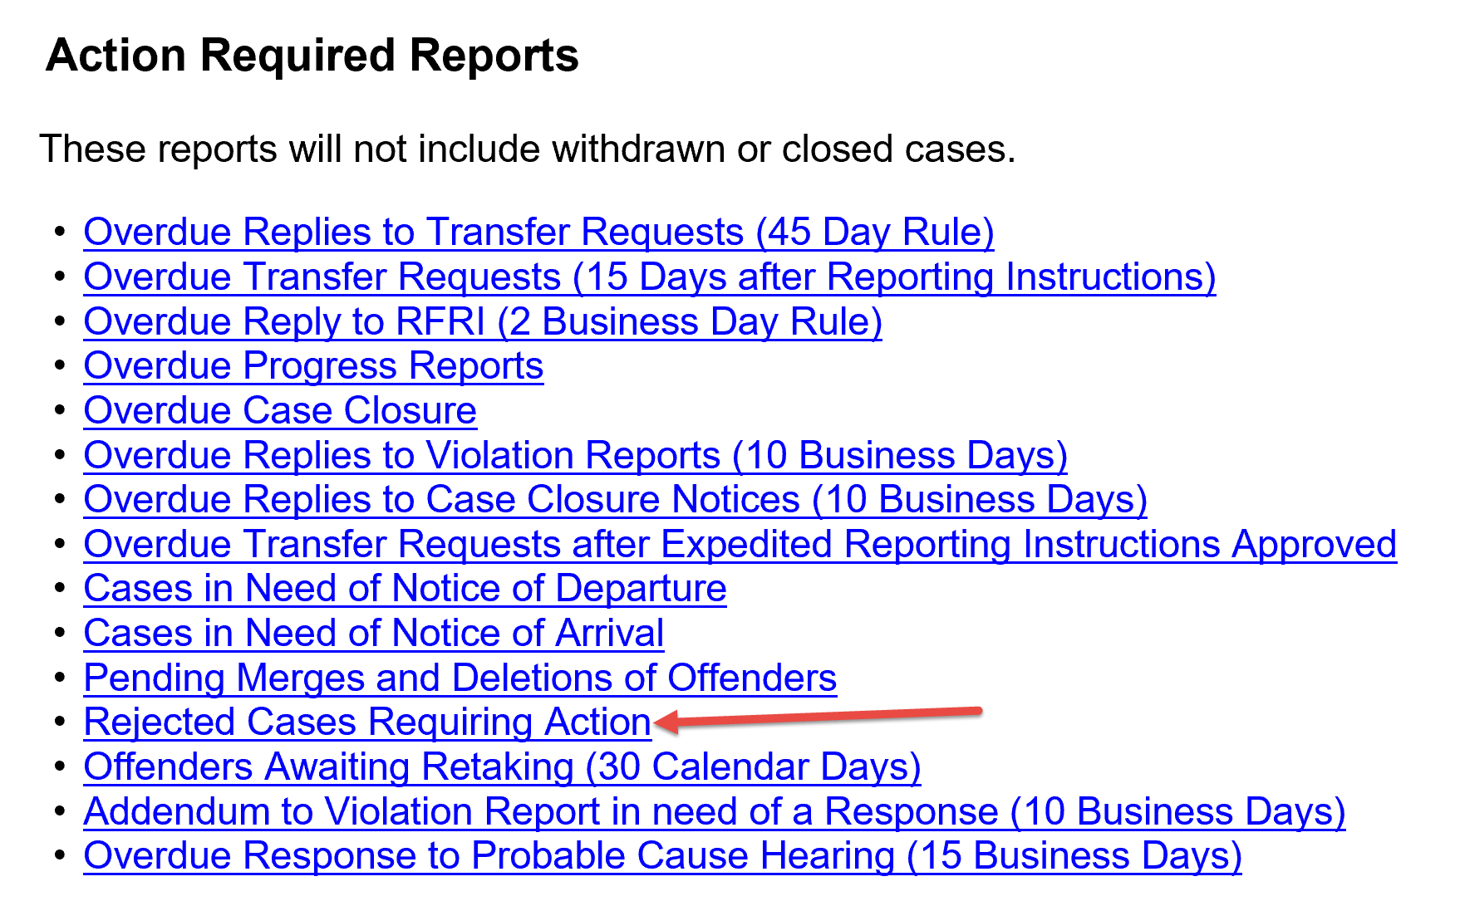
ICOTS Rejected Cases Report
Rejected-In the Sending State
Rejected-In the Receiving State
https://support.interstatecompact.org/entries/87675388-Rejected-Cases-Requiring-Action-Report
Notes:
Rejected-In the Sending State
No successful NOA
No reporting instructions
Rejecting-In the Receiving State
Previously issued Ris
Successfully arrived (NOA sent)
Transfer Request rejected
Review to determine whether
Transfer incomplete-offender may remain
Return RIs need to be requested

Slide 32
Return of Offenders in Lieu of Retaking Training Tips
Receiving State
RFRI sent within 7 business days of Violation Response
OVR reply indicates the offender is to be ordered to return in lieu of retaking
Sending State
Report date must be within 15 days of OVR
Notify victims if needed
Must provide Reporting Instructions
RS’s failure to request within 7 day timeframe does not eliminate obligation for RI’s
Warrant required if offender fails to return

Slide 33
Workflow for ALL Returns
Receiving State
Request RI's
NOD & CCN upon departure
Supervisory Authority Ends
Sending State
Respond to RFRI (2 days)
NOA confirm arrival
Failed to arrive? Issue Warrant
CCN Response
CASE CLOSED
Notes:
Request within 7 business days of event triggering the return: Rejection, Violation Response indicating return in lieu of retaking

Slide 34
Questions?

